Slide 1

Dream Team
Chasing the End

Slide 2
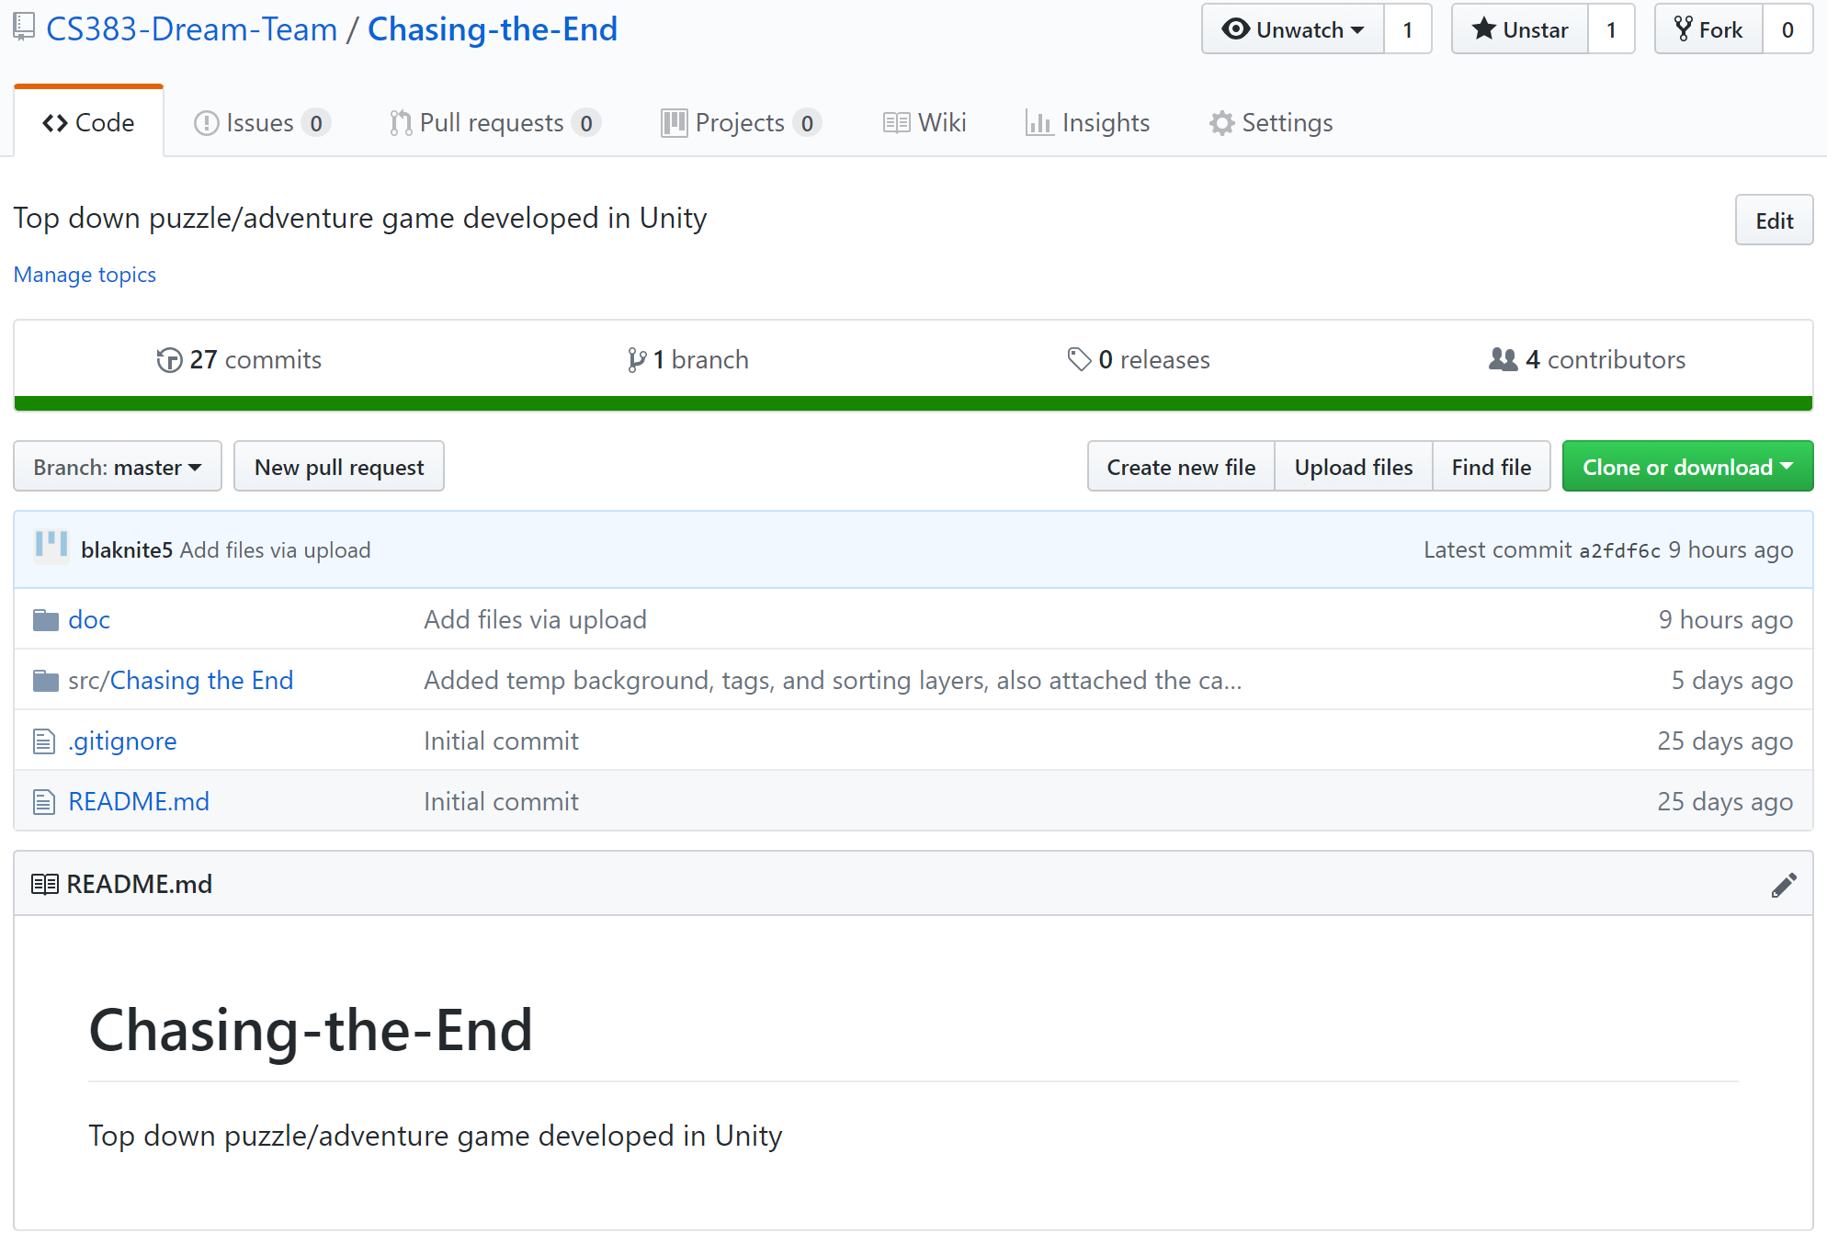
Root Directory and Folder Structure

Slide 3
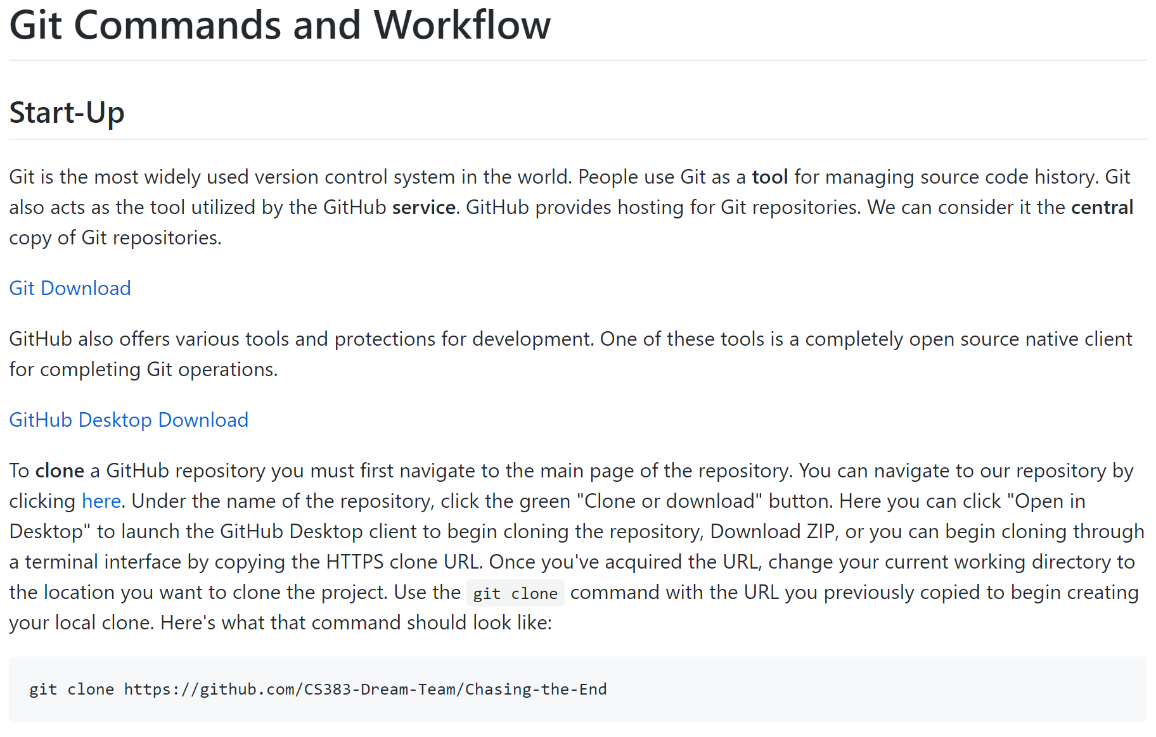
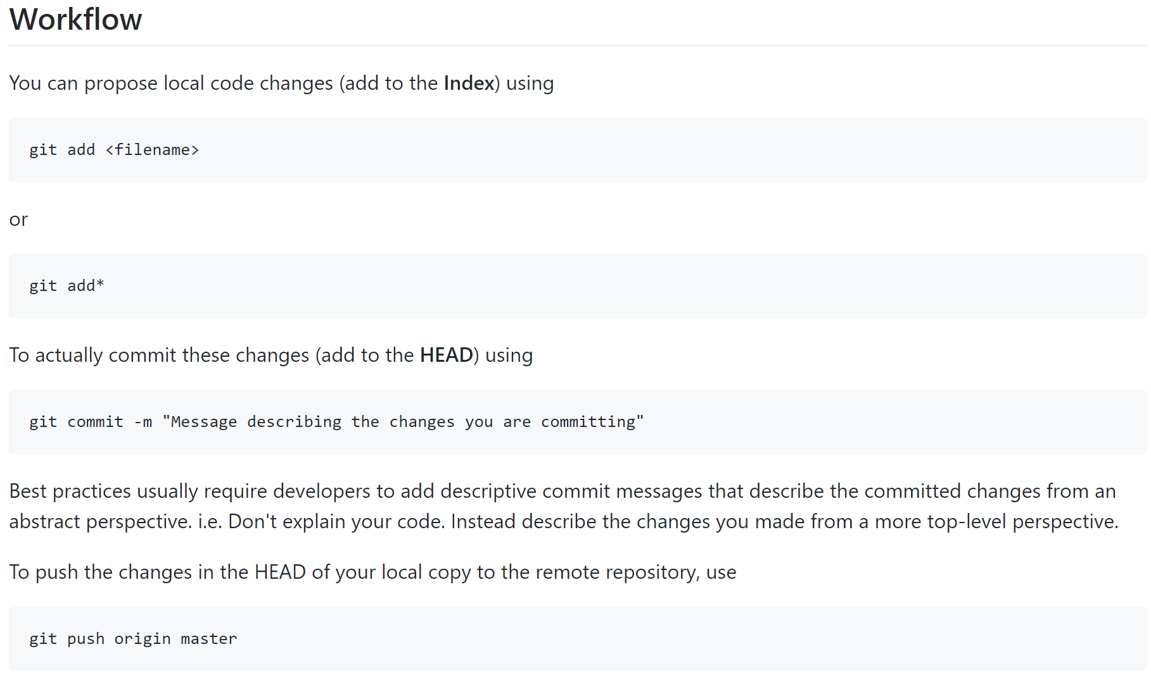
Resources

Slide 4
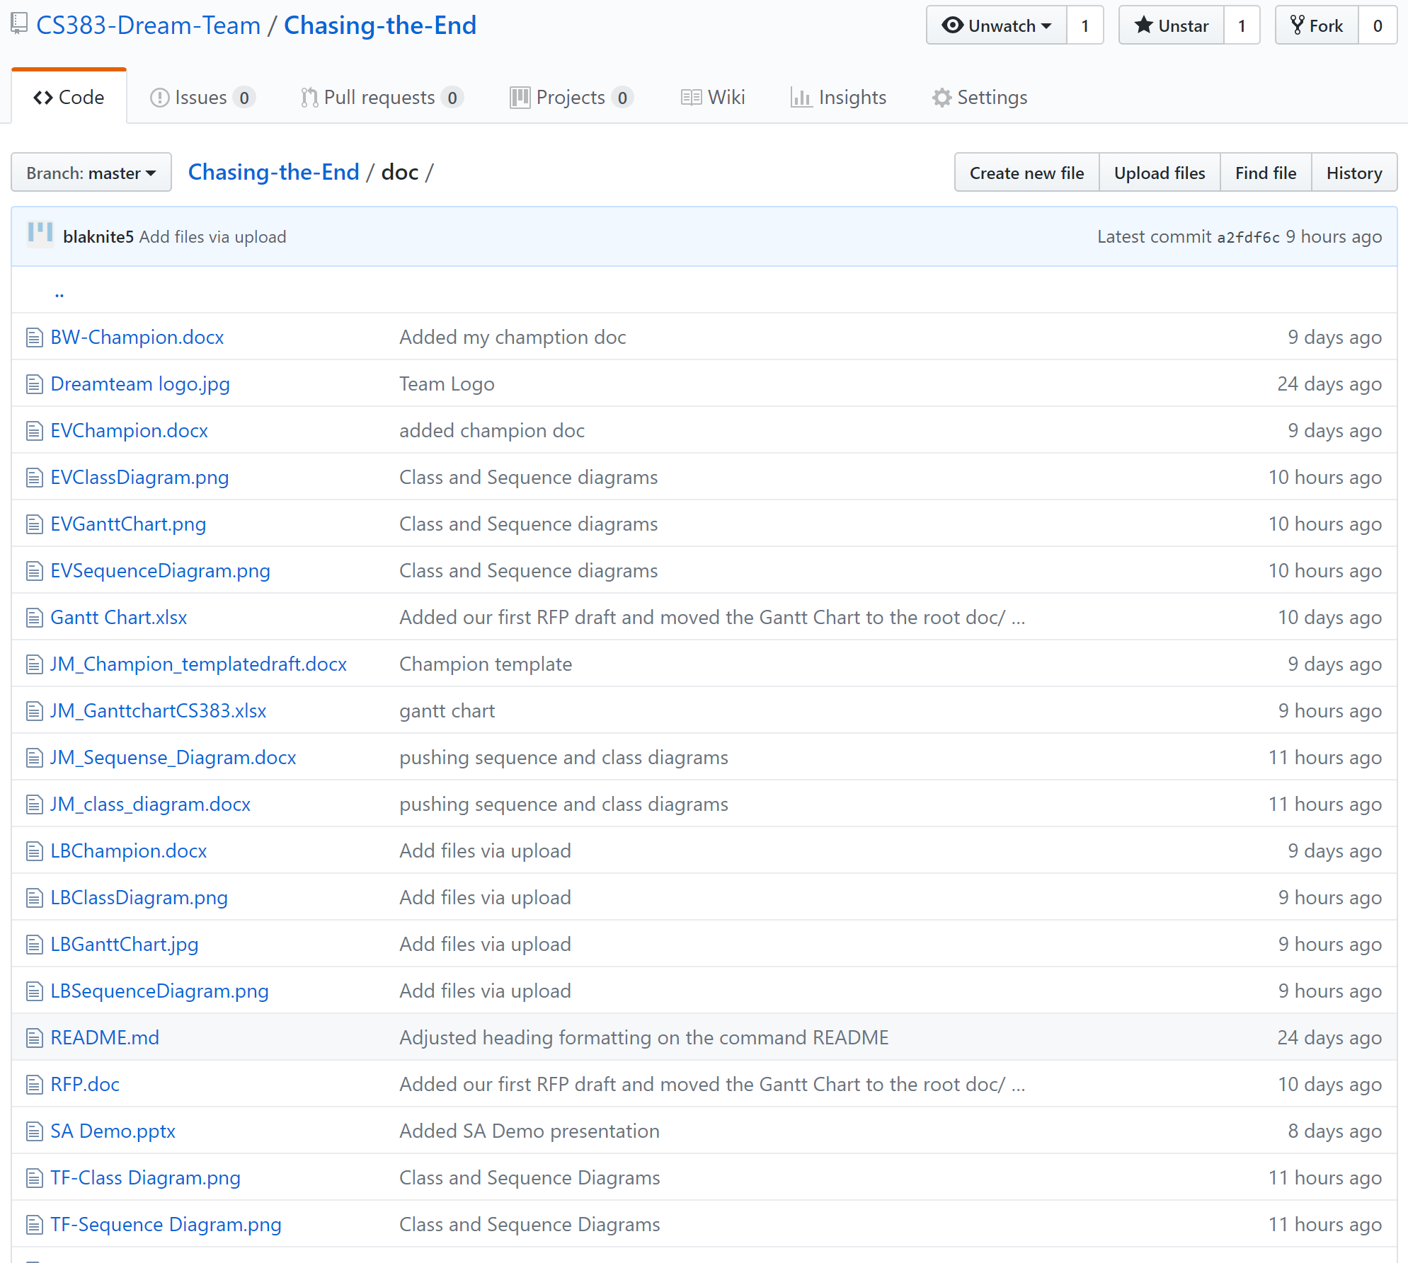
Repository Understanding

Slide 5
Any Questions?

